Slide 1
Intro to NLP
#deep learning classifiers
150116884 Esra Polat
150116071 Nur Deniz Çaylı
150116028 Minel Saygısever

Slide 2








Detail of Implementation
This program was implemented with Python on the Kaggle Notebook using the below libraries.

Slide 3
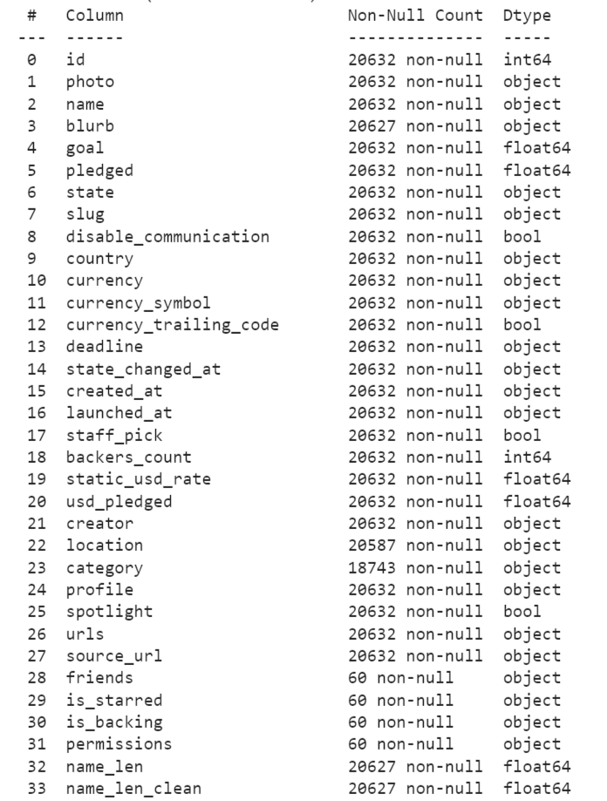
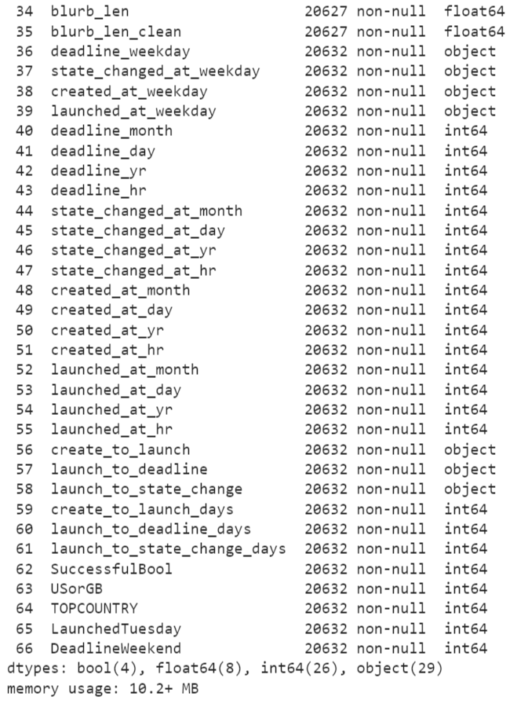

Detail of Dataset
We used the Kickstarter Campaigns Dataset
Data on more than 20,632 Kickstarter campaigns
from Kaggle*
kickstarter = pd.read_csv('../input/kickstarter-campaigns-dataset/kickstarter_data_full.csv', index_col=0)
# The dataset have 20632 entries of 67 features.
kickstarter.shape
kickstarter.info()

Slide 4
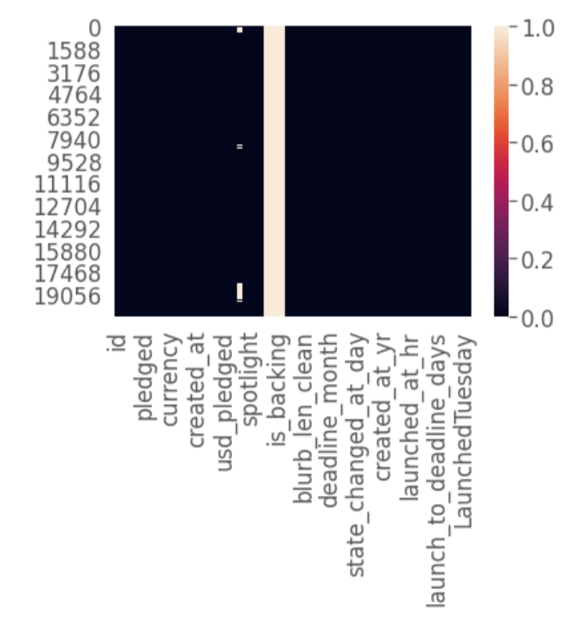
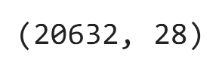
View Dataset
# looking here we can see that 'is_backing' and 'profile' contain missing values
sns.heatmap(kickstarter.isnull())
# friends, is_starred, is_backing, and permissions are looking weird
kickstarter['friends'].isnull().value_counts()
cols_to_drop = ['friends', 'is_starred', 'is_backing', 'permissions']
kickstarter.drop(labels=cols_to_drop, axis=1, inplace=True)
kickstarter.drop(labels='profile', axis=1, inplace=True)
#there are a lot of unnecessary features
second_col_drop = ['id','photo','slug','currency_symbol','currency_trailing_code',
'creator','location', 'urls','source_url','name_len','blurb_len','create_to_launch', 'launch_to_deadline', 'launch_to_state_change','USorGB','TOPCOUNTRY','LaunchedTuesday', 'DeadlineWeekend', 'deadline_month','deadline_day','deadline_yr','deadline_hr',
'state_changed_at_month','state_changed_at_day','state_changed_at_yr','state_changed_at_hr',
'created_at_month','created_at_day','created_at_yr','created_at_hr’,'launched_at_month',
'launched_at_day', 'launched_at_yr','launched_at_hr']
kickstarter.drop(labels=second_col_drop, axis=1, inplace=True)
# we reduced dimensionality from 67 to 28
kickstarter.shape
#converts type bool to 0 for false and 1 for true
kickstarter['disable_communication'] = kickstarter['disable_communication'] * 1
kickstarter['staff_pick'] = kickstarter['staff_pick'] * 1
kickstarter['spotlight'] = kickstarter['spotlight'] * 1

Slide 5
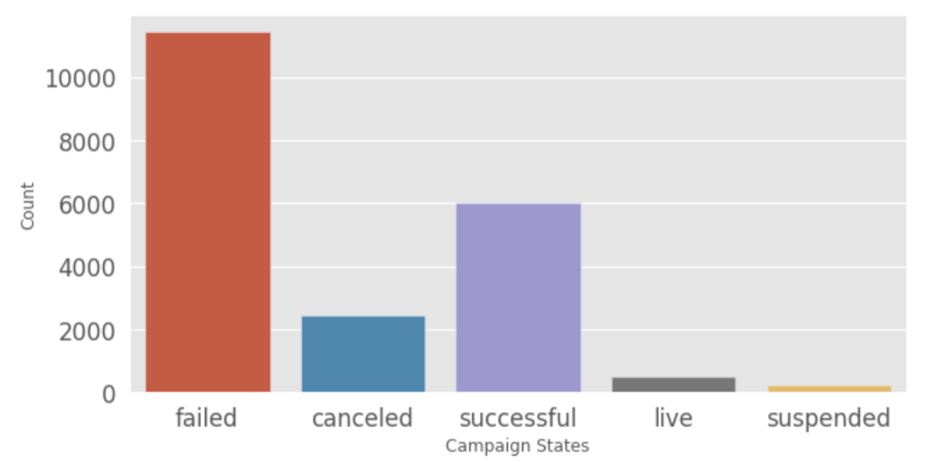
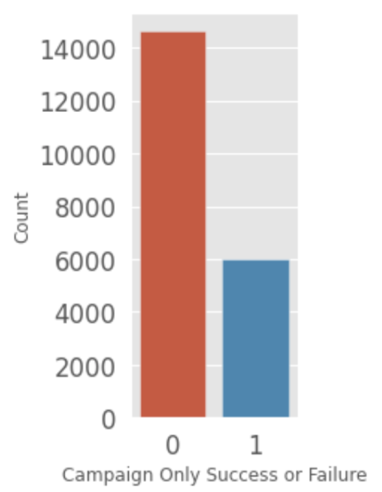
View Dataset
figsize(10, 5)
sns.countplot(kickstarter['state']);
plt.xlabel('Campaign States');
plt.ylabel('Count');
figsize(2, 5)
sns.countplot(kickstarter['SuccessfulBool']);
plt.xlabel('Campaign Only Success or Failure');
plt.ylabel('Count');

Slide 6
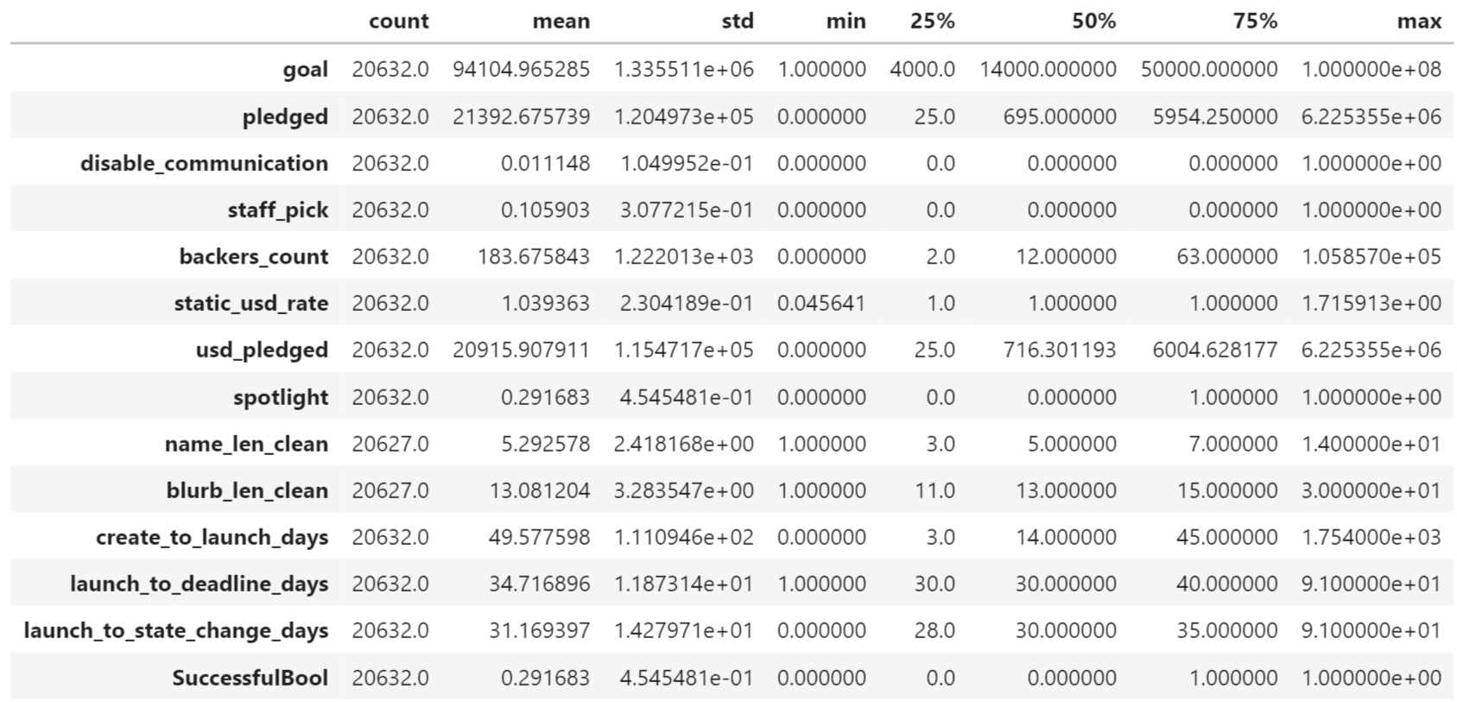
Interpretation
# when we look at the general statistics, we see how each feature covers a very different range.
kickstarter.describe().transpose()

Slide 7
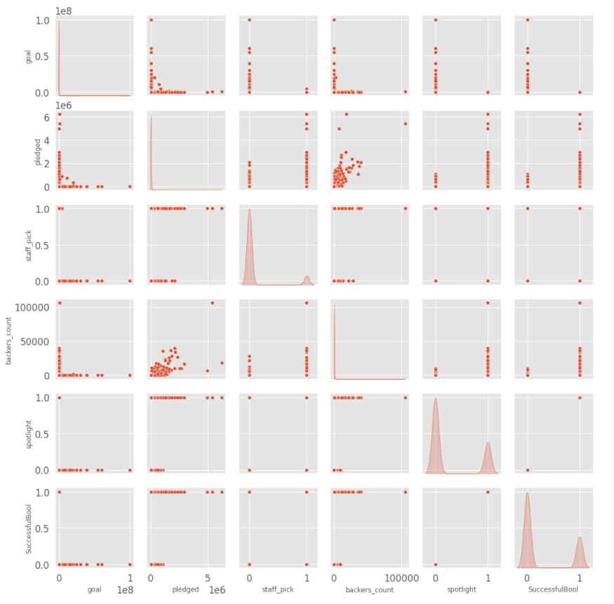
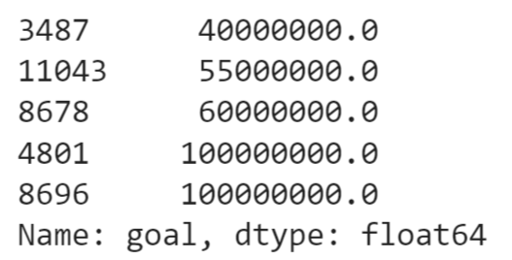
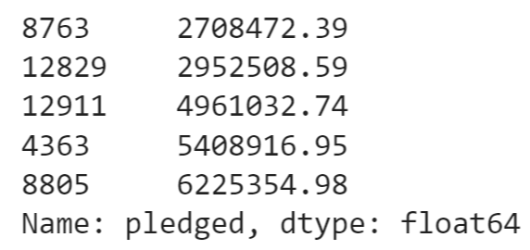
Interpretation
# Let's take a quick look at the common distribution of a few pairs of columns
sns.pairplot(kickstarter[['goal','pledged','staff_pick', 'backers_count', 'spotlight','SuccessfulBool']], diag_kind='kde')
# It looks like the goal variable has a huge spread
kickstarter['goal'].sort_values().tail()
# the pledged amount is more reasonable because this represents real money that people decided to give
kickstarter['pledged'].sort_values().tail()

Slide 8
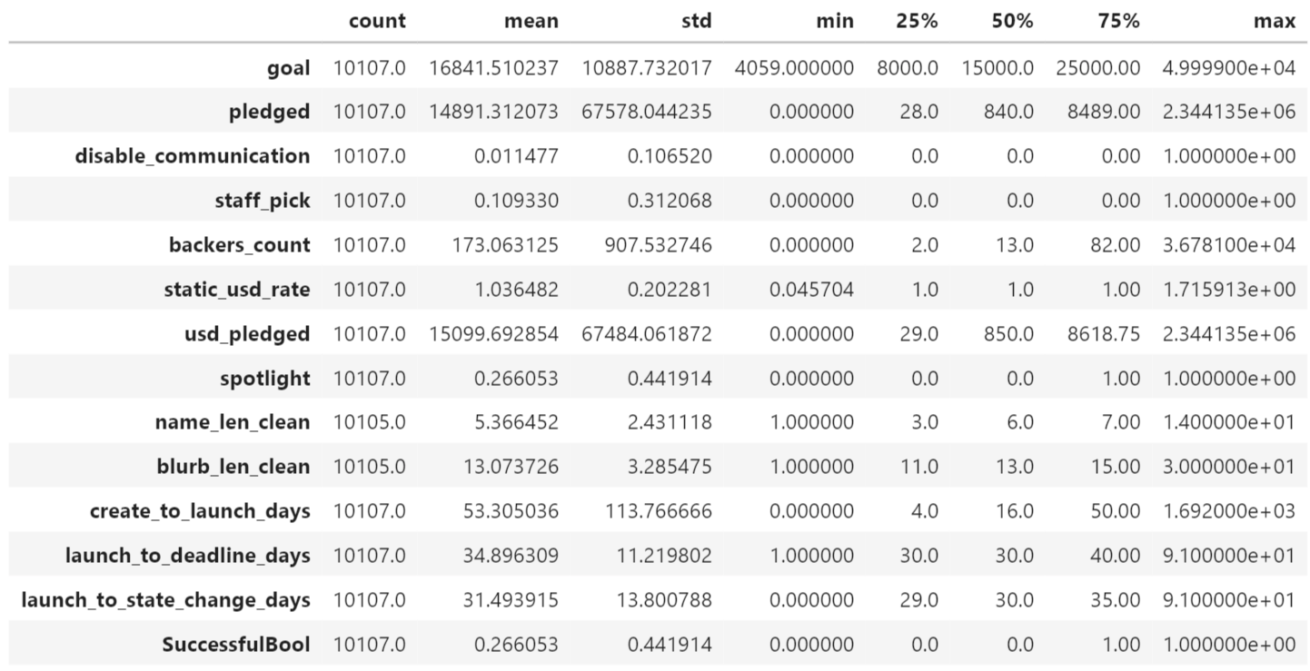
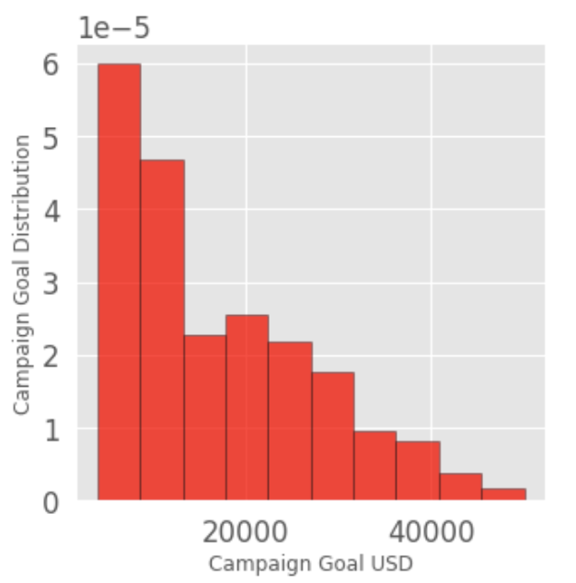
Interpretation
first_quartile = kickstarter['goal'].describe()['25%']
third_quartile = kickstarter['goal'].describe()['75%']
iqr = third_quartile - first_quartile
kickstarter_goal_iqr = kickstarter[(kickstarter['goal'] > first_quartile) & (kickstarter['goal'] < third_quartile)]
kickstarter_goal_iqr.describe().transpose()
figsize(5, 5)
plt.hist(kickstarter_goal_iqr['goal'], 10, density = 10,
color ='red',edgecolor = 'black', alpha = 0.7)
plt.xlabel('Campaign Goal USD')
plt.ylabel('Campaign Goal Distribution')
plt.show()

Slide 9
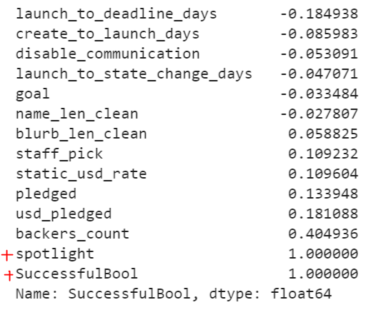
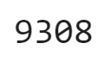
Outlier Data
# trim backers_count, pledged and create_to_launch_days then create
# a new IQR dataframe with these truncated values
kickstarter_iqr_trimmed = kickstarter_goal_iqr
first_quartile = kickstarter['create_to_launch_days'].describe()['25%']
third_quartile = kickstarter['create_to_launch_days'].describe()['75%']
iqr = third_quartile - first_quartile
kickstarter_iqr_trimmed = kickstarter[(kickstarter['create_to_launch_days'] >
first_quartile) & (kickstarter['create_to_launch_days'] < third_quartile)]
first_quartile = kickstarter['pledged'].describe()['25%']
third_quartile = kickstarter['pledged'].describe()['75%']
iqr = third_quartile - first_quartile
kickstarter_iqr_trimmed = kickstarter[(kickstarter['pledged'] >
first_quartile) & (kickstarter['pledged'] < third_quartile)]
first_quartile = kickstarter['backers_count'].describe()['25%']
third_quartile = kickstarter['backers_count'].describe()['75%']
iqr = third_quartile - first_quartile
kickstarter_iqr_trimmed = kickstarter[(kickstarter['backers_count'] >
first_quartile) & (kickstarter['backers_count'] < third_quartile)]
# This reduction resulted in a dataframe where there are 9308 instances,
# with only the IQR for the variables in question remaining.
len(kickstarter_iqr_trimmed)
# correlations btw each variable against SuccessfulBool, which remember, is a binary value where 0=failed and 1=succeeded
kickstarter_iqr_trimmed.corr()['SuccessfulBool'].sort_values()

Slide 10
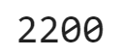
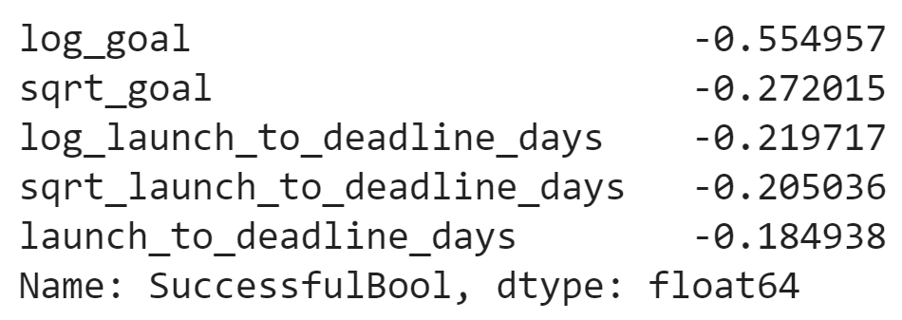
Outlier Data
# Looking at the correlations above we can see that nothing is too strongly correlated except spotlight, backers_count, pledged, and staff_pick
# But really the only significant ones are backers_count and spotlight
len(kickstarter_iqr_trimmed[kickstarter_iqr_trimmed['spotlight'] == 1])
# taken together with the spotlight variable's correlation to SuccessfulBool, we can conclude that all spotlighted campaigns were successful,
# at least in this dataset, taking into account the fact that it is reduced to IQR values only
len(kickstarter_iqr_trimmed[kickstarter_iqr_trimmed['SuccessfulBool'] == 1])
# we are going to pool together these strongly correlated features for feature selection
reduced_x_features = kickstarter_iqr_trimmed[['launch_to_deadline_days', 'staff_pick', 'pledged', 'backers_count', 'spotlight', 'goal']]
reduced_y = kickstarter_iqr_trimmed[['SuccessfulBool']]
# Because of the original format of the variables, we need to take the log and sqrt transformations of them and check correlation with those
# as well to account for non-linear relationships
numeric_subset = kickstarter_iqr_trimmed.select_dtypes('number')
for col in numeric_subset.columns:
if col == 'SuccessfulBool': next
else: numeric_subset['sqrt_' + col] = np.sqrt(numeric_subset[col])
numeric_subset['log_' + col] = np.log(numeric_subset[col])
categorical_subset = kickstarter_iqr_trimmed['category']
categorical_subset = pd.get_dummies(categorical_subset)
features = pd.concat([numeric_subset, categorical_subset], axis = 1)
features = features.dropna(subset = ['SuccessfulBool'])
correlations = features.corr()['SuccessfulBool'].dropna().sort_values()
correlations.head()

Slide 11
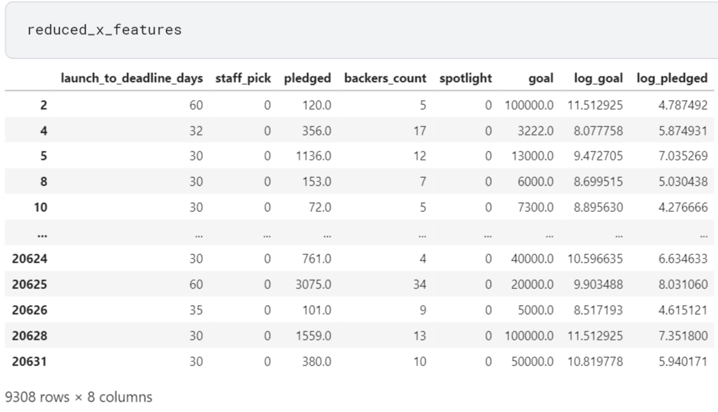
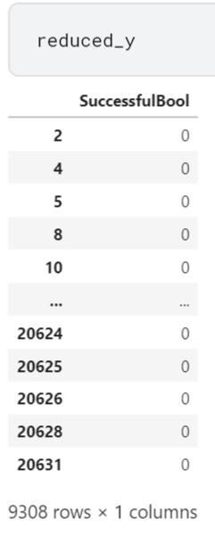
Outlier Data
# we saw in the previous step that goal got a boost in correlation what you take its log, so we will add log_goal into the reduced_x_features
# dataframe and saw log_pledged show a significant boost as well, so that will be included
reduced_x_features['log_goal'] = features['log_goal']
reduced_x_features['log_pledged'] = features['log_pledged']

Slide 12
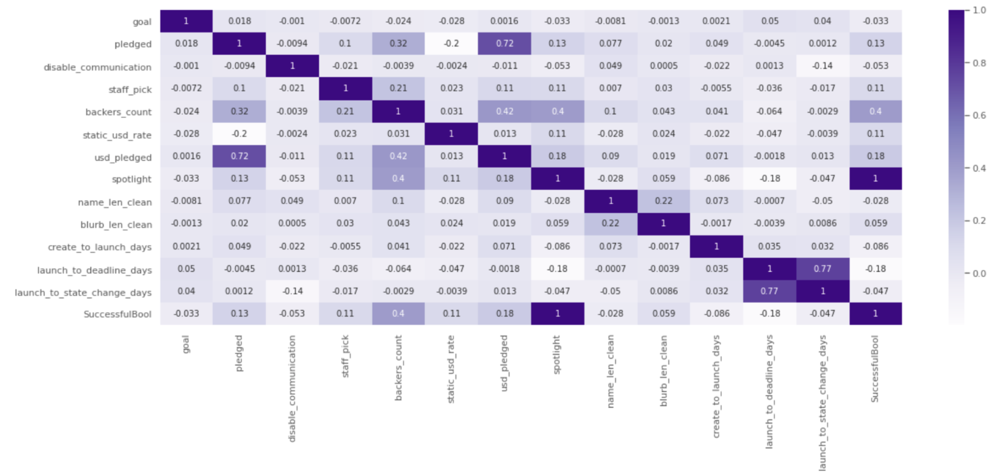
View Dataset
# when we transformed goal and pledged to log_goal and log_pledged, we found that these had a stronger correlation than their original forms,
# so these new features were added to reduced_x_feature
figsize(14,5)
sns.heatmap(kickstarter_iqr_trimmed.corr(), annot=True, annot_kws={"size": 9}, cmap="Purples")

Slide 13
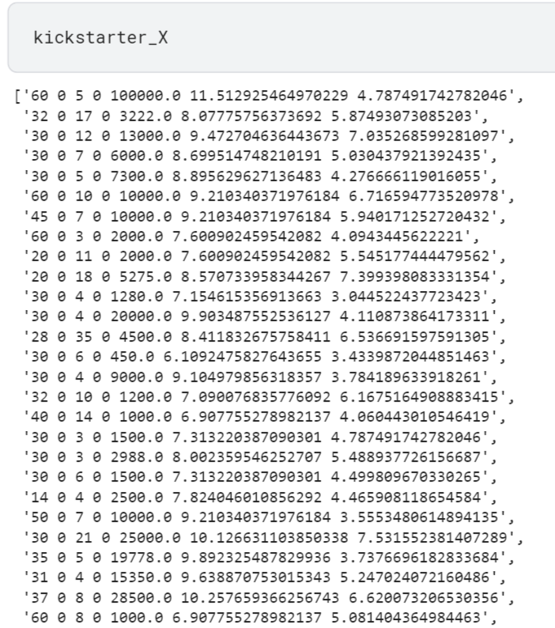
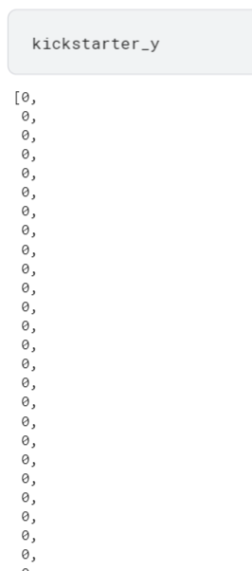
Before the model..
kickstarter_X = []
kickstarter_y = []
for i, j in reduced_x_features.iterrows():
tmp = str(reduced_x_features['launch_to_deadline_days'][i]) + " " + str(reduced_x_features['staff_pick'][i]) + " " + \
str(reduced_x_features['backers_count'][i]) + " " + str(reduced_x_features['spotlight'][i]) + " " + \
str(reduced_x_features['goal'][i]) + " " + str(reduced_x_features['log_goal'][i]) + " " + str(reduced_x_features['log_pledged'][i])
kickstarter_X.append(tmp)
kickstarter_y.append(int(reduced_y['SuccessfulBool'][i]))
max_words = 2000
max_length = 30
vector_length = 16
encoded_docs = [one_hot(d, max_words) for d in kickstarter_X]
padded_docs = pad_sequences(encoded_docs, maxlen=6, padding='post')
X_train, X_test, y_train, y_test = train_test_split(padded_docs,
np.array(kickstarter_y)[:, None].astype(int),
test_size=0.20,
random_state=1234)

Slide 14
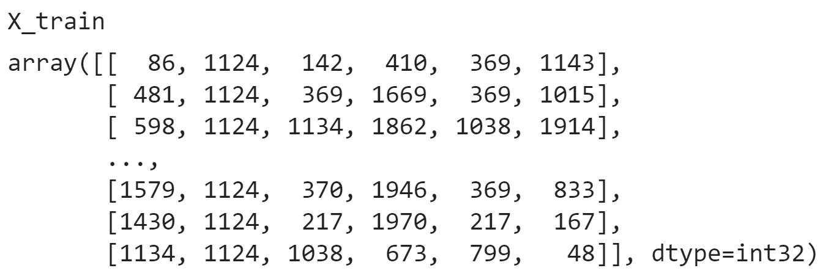
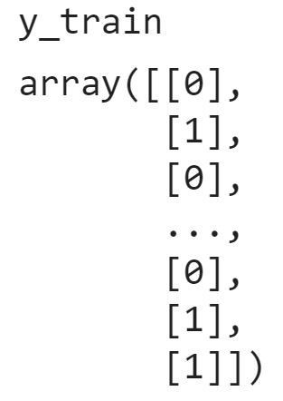
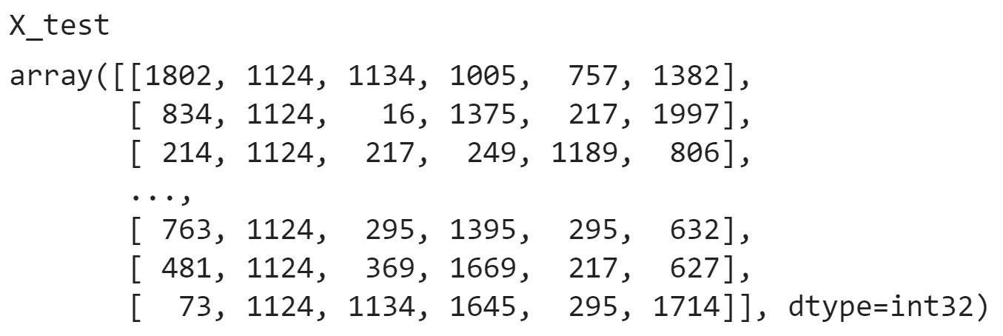
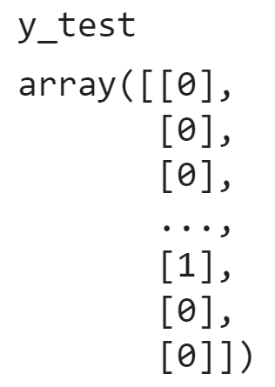
Data Sets

Slide 15

CNN (Convolutional Neural Network)
Convolutional neural network (CNN, or ConvNet) is a class of deep neural network, most commonly applied to analyze visual imagery.^{[1]} They are also known as shift invariant or space invariant artificial neural networks (SIANN), based on the shared-weight architecture of the convolution kernels or filters that slide along input features and provide translation equivariant responses known as feature maps.^{[2][3]}

Slide 16
Prediction of Successful with CNN
# Initialising the RNN
model = Sequential()
# Adding the first CNN layer and Dropout layer
model.add(Dense(128, activation="relu", input_shape=(X_train.shape[1],)))
model.add(Dropout(0.2))
# Adding a second CNN layer and Dropout layer
model.add(Dense(64, activation="relu"))
model.add(Dropout(0.2))
# Adding a third CNN layer and Dropout layer
model.add(Dense(32, activation="relu"))
model.add(Dropout(0.2))
# Adding a fourth CNN layer and Dropout layer
model.add(Dense(16, activation="relu"))
model.add(Dropout(0.2))
# For Full connection layer we use dense as the output is 1D so we use unit=1 adding the output layer
model.add(Dense(1))
print(model.summary())
model.compile(loss='mean_squared_error', optimizer='adam', metrics=['acc'])
history = model.fit(X_train, y_train, epochs=50, verbose=1,validation_data=(X_test, y_test), batch_size=256)
scores = model.evaluate(X_test, y_test, verbose=1,batch_size = 256)
dt = RandomForestRegressor(criterion='mae', n_jobs=-1, n_estimators=10,max_depth=7, min_samples_leaf=1, random_state=3)
dt.fit(X_train,y_train)
y_predicted = dt.predict(X_test)
accuracy = dt.score(X_test,y_test)

Slide 17
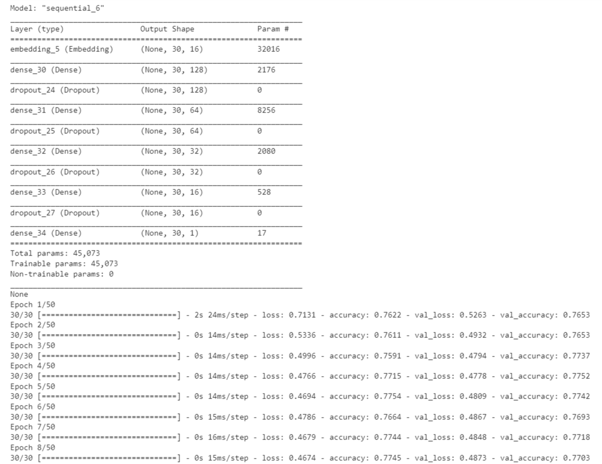
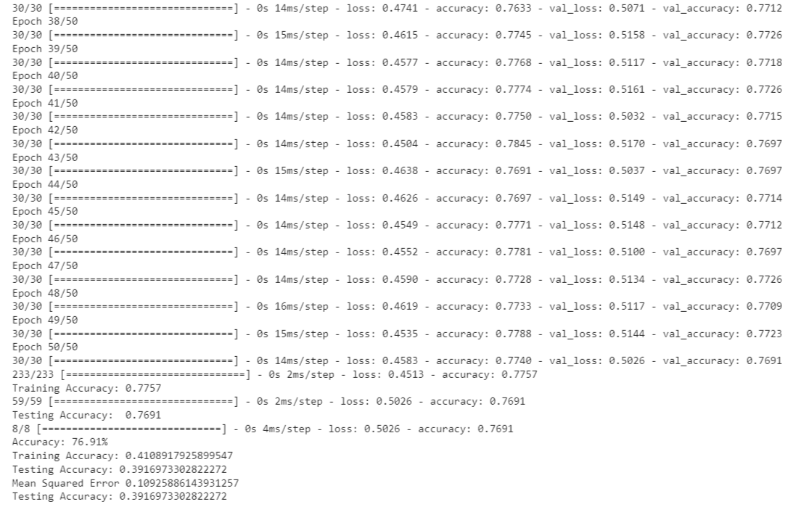

Slide 18
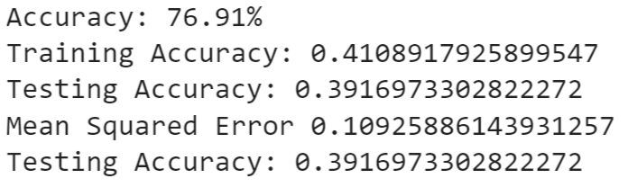
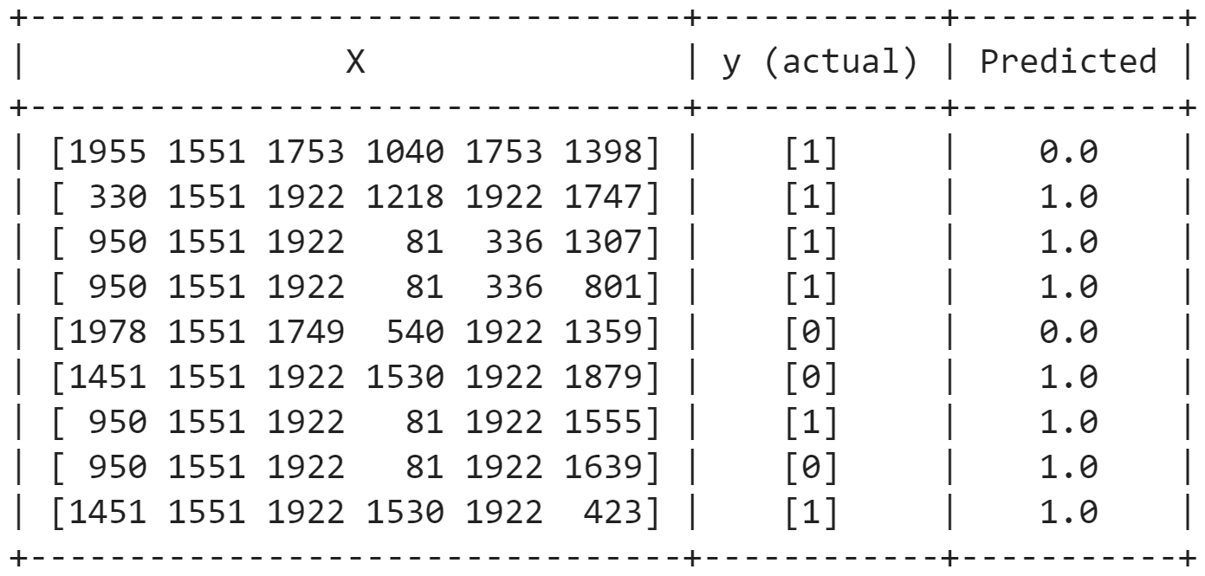
a few example from results
✖
✔
✔
✔
✔
✖
✔
✖
✔

Slide 19
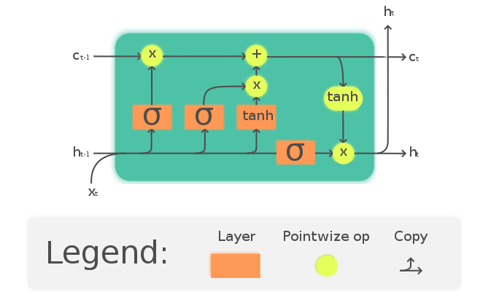
LSTM (Long Short-Term Memory)
Long short-term memory (LSTM) is an artificial recurrent neural network (RNN) architecture^{[1]} used in the field of deep learning. Unlike standard feedforward neural networks, LSTM has feedback connections. The Long Short-Term Memory (LSTM) cell can process data sequentially and keep its hidden state through time.

Slide 20
Prediction of Successful with LSTM
# Initialising the RNN
model = Sequential()
model.add(layers.Embedding(max_words+1, vector_length, input_length=max_length))
# Adding the first LSTM layer and Dropout layer
model.add(LSTM(units = 128, return_sequences = True, input_shape = (X_train.shape[1], 1)))
model.add(Dropout(0.2))
# Adding a second LSTM layer and Dropout layer
model.add(LSTM(units = 64, return_sequences = True))
model.add(Dropout(0.2))
# Adding a third LSTM layer and Dropout layer
model.add(LSTM(units = 32, return_sequences = True))
model.add(Dropout(0.2))
# Adding a fourth LSTM layer and Dropout layer
model.add(LSTM(units = 16))
model.add(Dropout(0.2))
# For full connection layer we use dense as the output is 1D so we use unit=1 adding the output layer
model.add(Dense(1, activation= 'relu'))
print(model.summary())
model.compile(loss='binary_crossentropy', optimizer='adam', metrics=['accuracy'])
history = model.fit(X_train, y_train, epochs=50, verbose=1,validation_data=(X_test, y_test),batch_size=256)
scores = model.evaluate(X_test, y_test, verbose=1,batch_size = 256)
dt = RandomForestRegressor(criterion='mae',n_jobs=-1, n_estimators=10,max_depth=6, min_samples_leaf=1, random_state=3)
dt.fit(X_train,y_train)
y_predicted = dt.predict(X_test)
accuracy = dt.score(X_test,y_test)

Slide 21
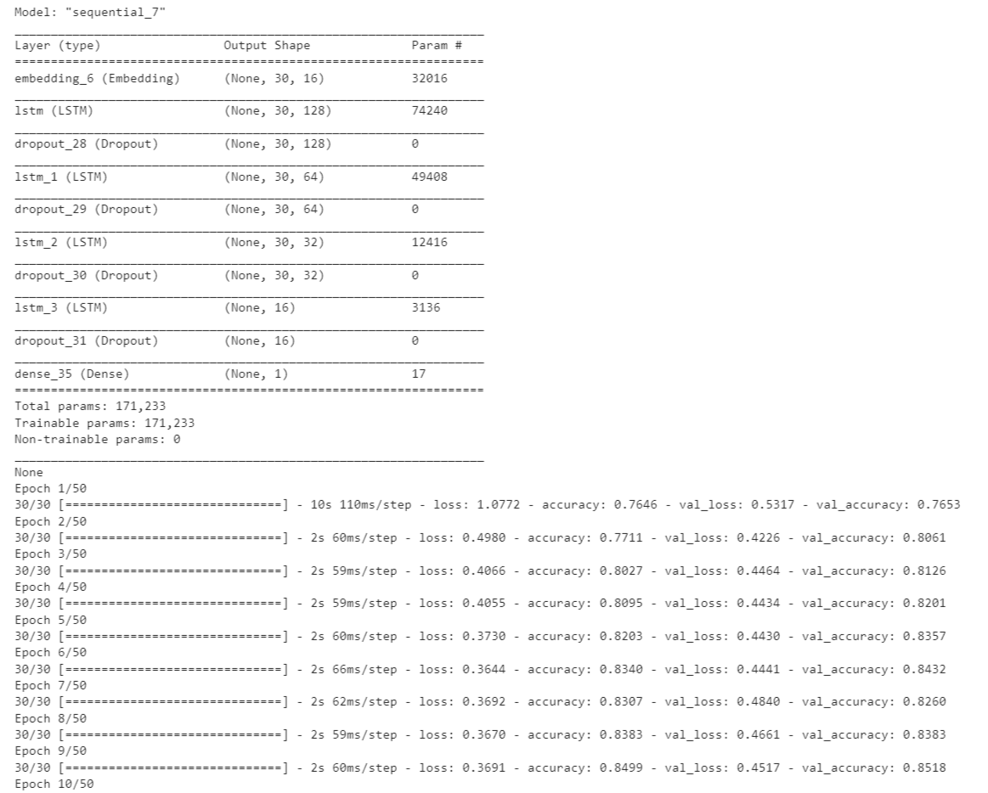
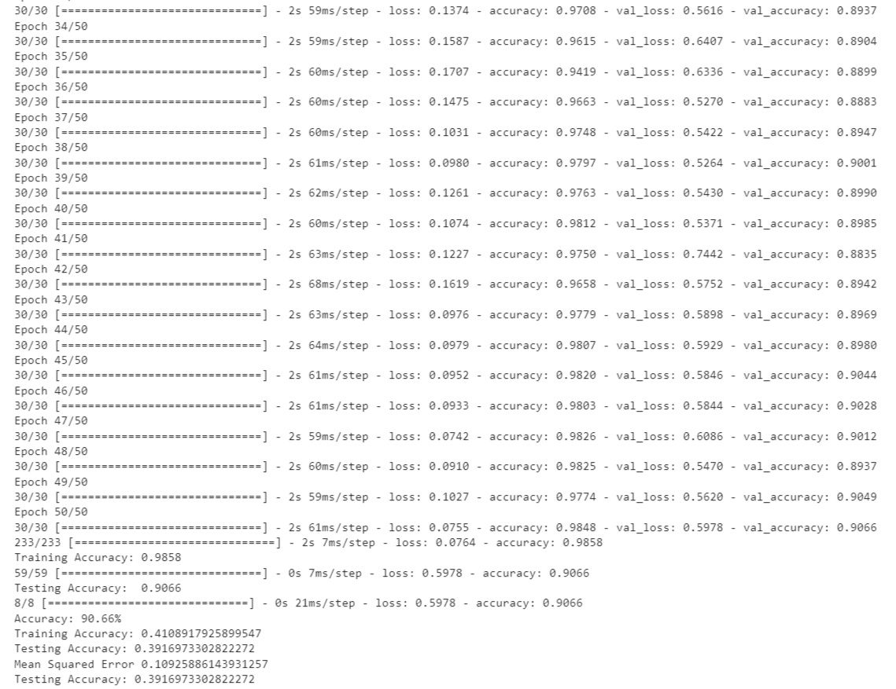

Slide 22
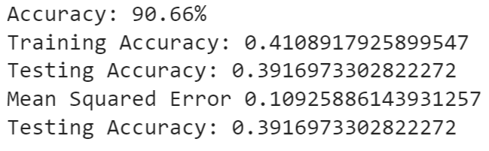
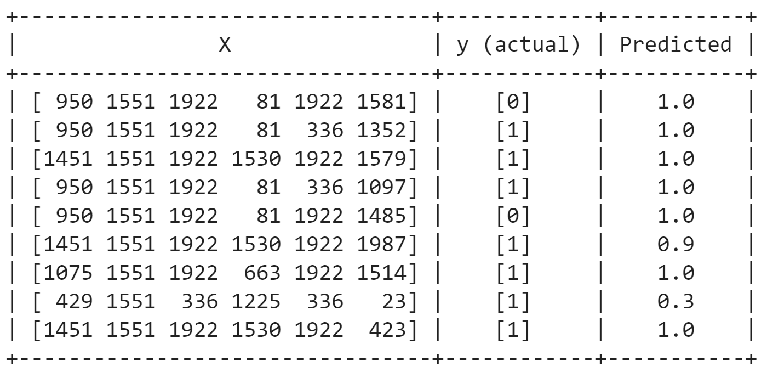
a few example from results
✖
✔
✔
✔
✖
~
✔
~
✔

Slide 23
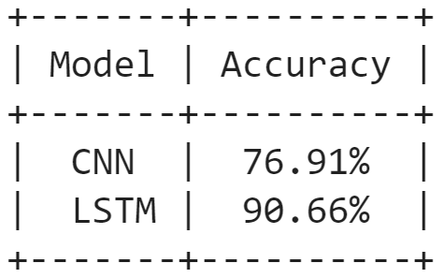
Comparison Results for Successful Prediction
We can see that LSTM is more successful and sensitive in these calculations where we use the success status as the y variable. When we compared the results below, we can say that: When we search the answer of ‘predict if a project/campaign will be successful or not’, the LSTM algorithm works better than the CNN algorithm.

Slide 24
Prediction of the Amount of Money Collected
We have done all the operations we mentioned in the previous slides for the "Pledged" value instead of "Successful State". Therefore, we don’t again explain the same steps. We want to add a few important details about pledged value. We use the pledged as the y variable. Our x variables are the same.

Slide 25
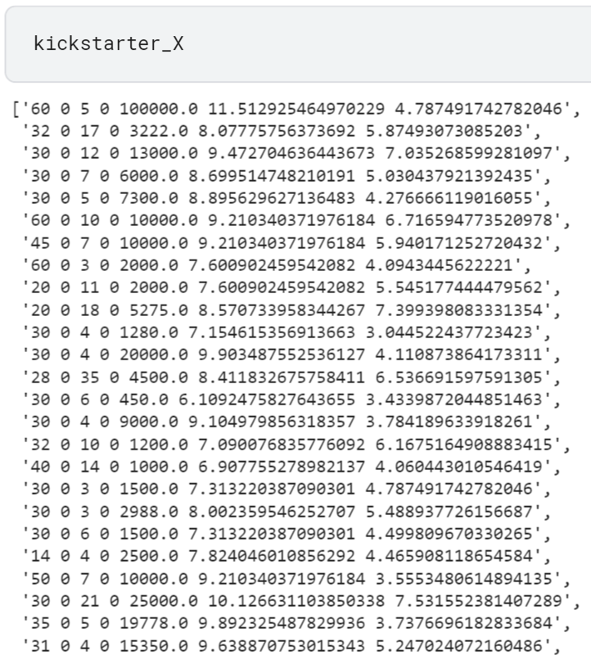
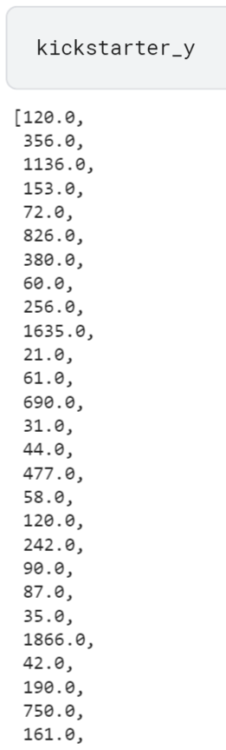
Before the model..
kickstarter_X = []
kickstarter_y = []
for i, j in reduced_x_features.iterrows():
tmp = str(reduced_x_features['launch_to_deadline_days'][i]) + " " + \
str(reduced_x_features['staff_pick'][i]) + " " + \
str(reduced_x_features['backers_count'][i]) + " " + \
str(reduced_x_features['spotlight'][i]) + " " + \
str(reduced_x_features['goal'][i]) + " " + \
str(reduced_x_features['log_goal'][i]) + " " + \
str(reduced_x_features['log_pledged'][i])
kickstarter_X.append(tmp)
kickstarter_y.append(reduced_y['pledged'][i])
max_words = 2000
max_length = 30
vector_length = 16
encoded_docs = [one_hot(d, max_words) for d in kickstarter_X]
padded_docs = pad_sequences(encoded_docs, maxlen=7, padding='post')
X_train, X_test, y_train, y_test = train_test_split(padded_docs,
np.array(kickstarter_y)[:, None].astype(int), test_size=0.20,
random_state=1234)

Slide 26
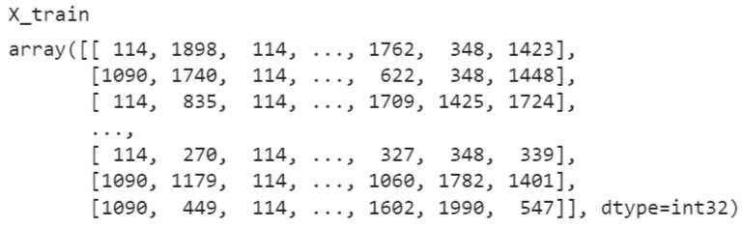
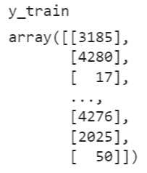
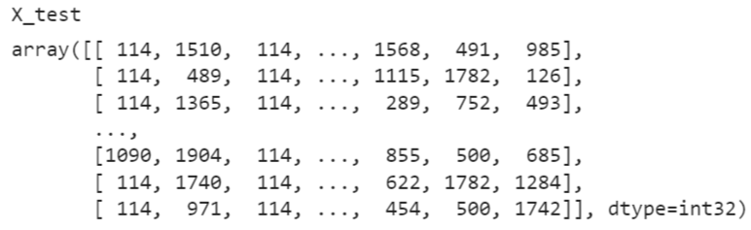
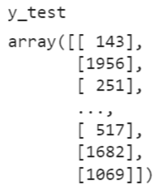
Data Sets

Slide 27
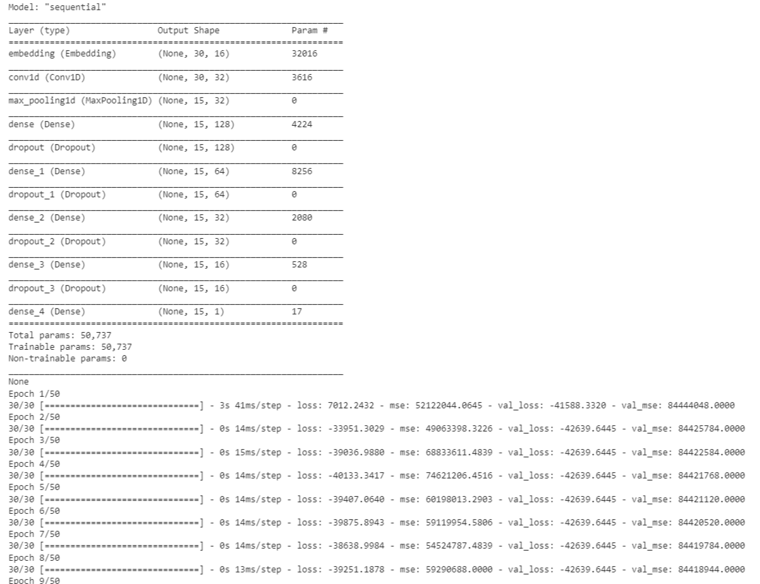
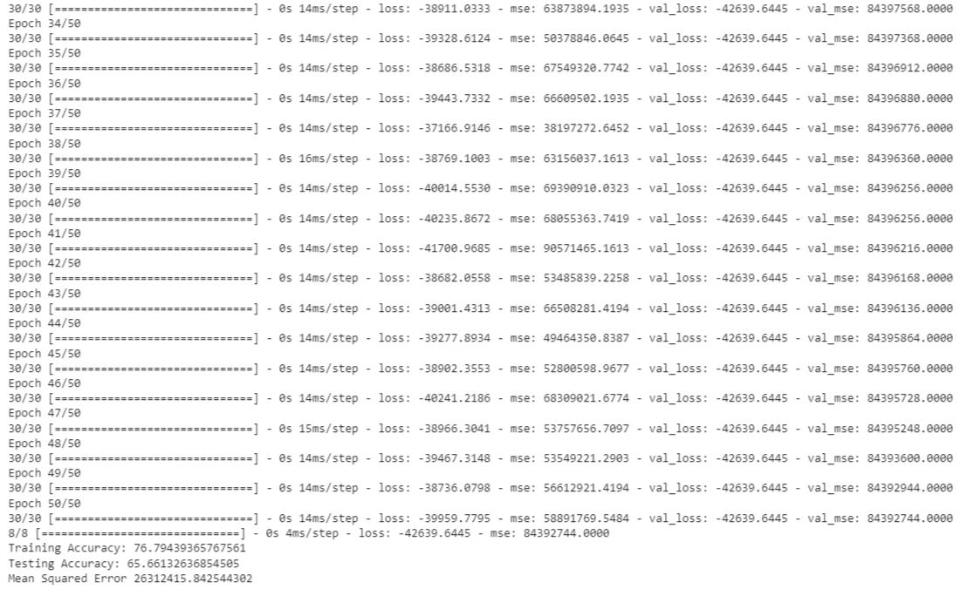
Prediction of Amount of Money Collected with CNN

Slide 28
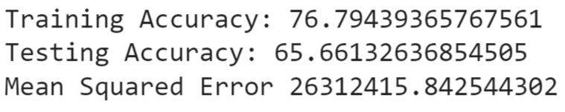
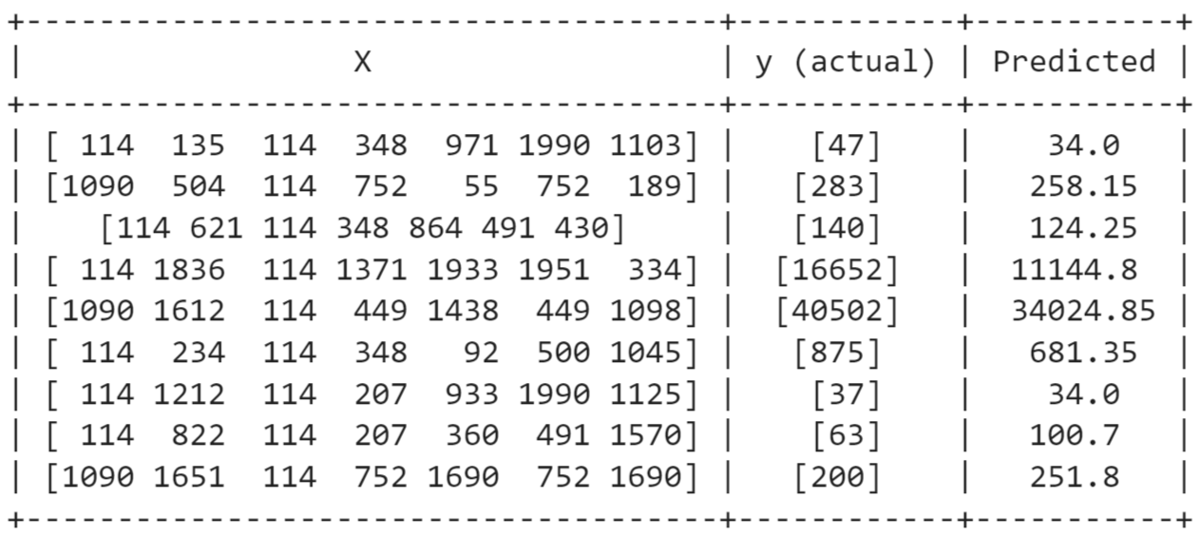
a few example from results

Slide 29
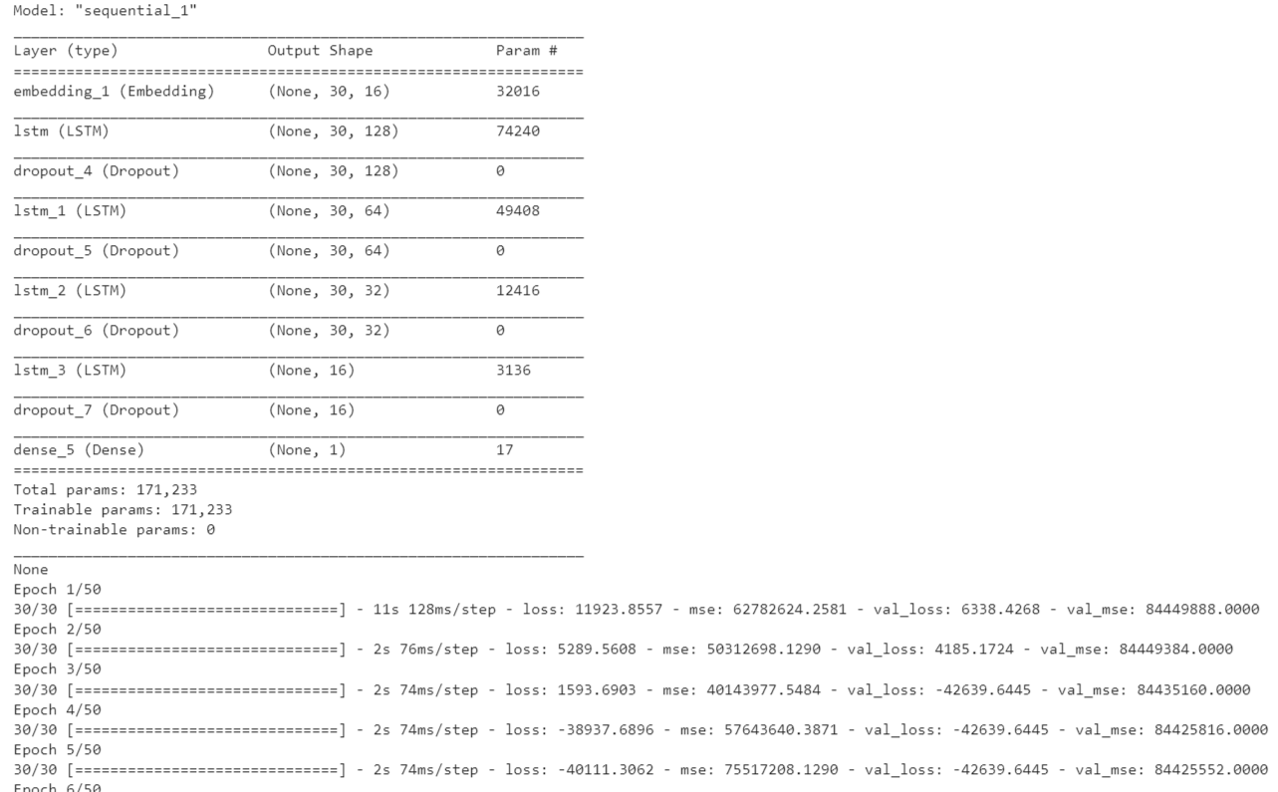
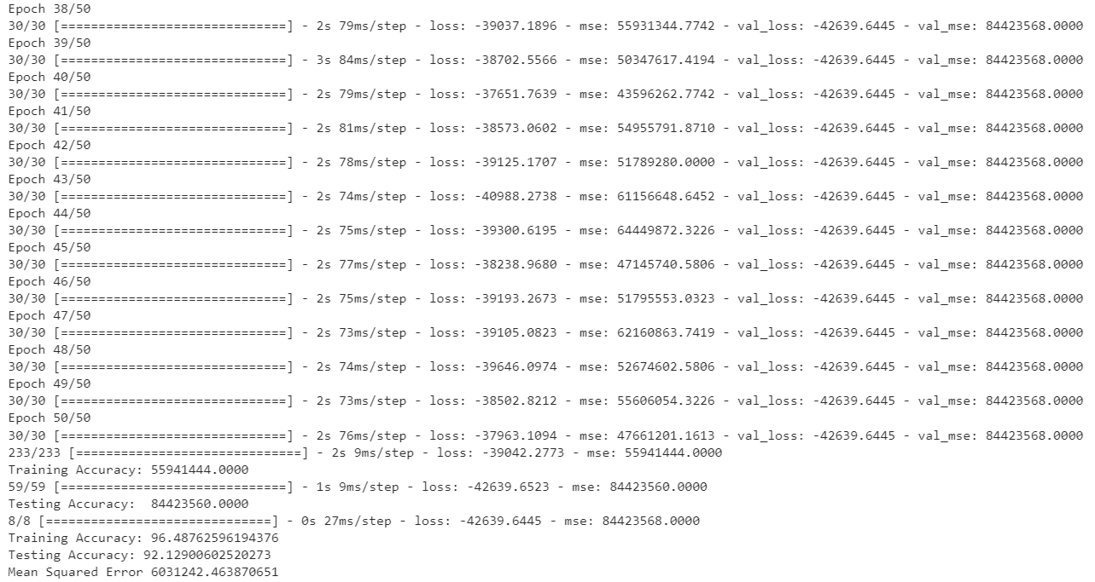
Prediction of Amount of Money Collected with LSTM

Slide 30
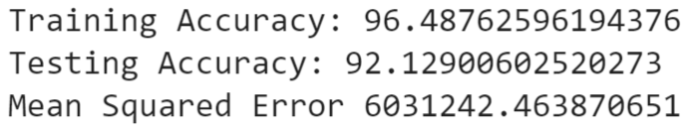
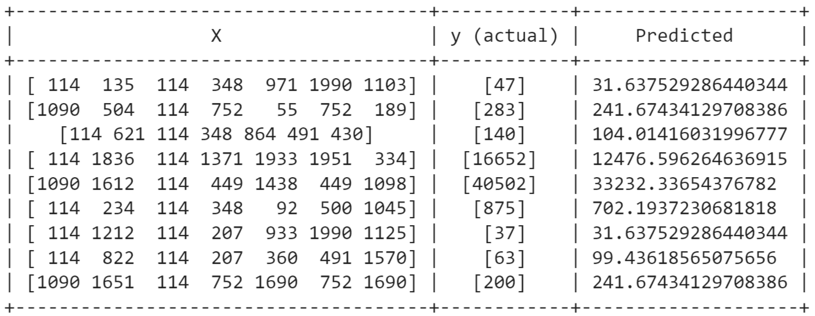
a few example from results

Slide 31
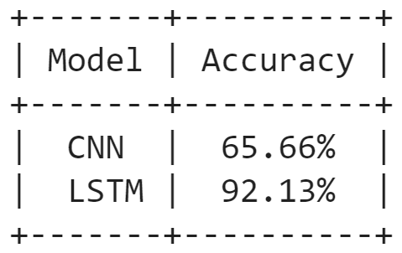
Comparison Results for Amount of
Money Collected Prediction
We can see that LSTM is more successful and sensitive in these calculations where we use the pledged as the y variable. When we compared the results below, we can say that: When we search the answer of ‘predict the amount of money collected’, the LSTM algorithm works better than the CNN algorithm. In addition, we observed that LSTM gives more sensitive results.

Slide 32
Utilized Resources
Keras: Multiple Inputs and Mixed Data
House Price Prediction using Machine Learning
Long Short Term Memory (LSTM)
Time Series Prediction with LSTM Recurrent Neural Networks in Python with Keras
CNN Long Short-Term Memory Networks
Convolutional Neural Networks in Python with Keras
How to Make Predictions with Keras
How to Make Predictions with scikit-learn
Text classification using CNN
Dense neural netLSTM and CNN on IMDB

